Slide 1

FHIR-Based Child Nutrition Survey
Digital Nutrition Data Collection for Improved Health Outcomes
Group Members :
Binaya Poudel
Monika Bhujel
Muna Paudel
Ritu Bhele

Slide 2
Project Overview & Workflow
Goal: Digitize and standardize nutrition and demographic data collection tool for children.
Our Approach:
Identify Child Nutrition Tools
Mapping questionnaire as per the to FHIR resources
Structure data in FHIR-compliant JSON
Address challenges and barriers

Slide 3
Introduction
FHIR FHIR (Fast Healthcare Interoperability Resources) is a global standard for exchanging healthcare data electronically.
Standardized data collection
Interoperability across systems
Integration of semantic codes (ICD, SNOMED, LOINC)
Efficient care coordination
Real-time monitoring and alerts
Decision support systems

Slide 4
FHIR Syntactic and Semantic Interoperability in Child Nutrition: Lab, Symptom, and Diagnosis Mapping
FHIR Use Cases Related to Child Nutrition
FHIR + SNOMED for Symptoms – Observation Symptom: Wasting in child (SNOMED CT: 271327008) → Represented using Observation resource.
FHIR + ICD for Diagnosis – Condition Diagnosis: Severe Acute Malnutrition (SAM) (ICD-10: E43) → Represented using Condition resource.
FHIR + LOINC for Lab Tests – Observation Test: Hemoglobin [Mass/volume] in Blood (LOINC: 718-7) → Represented using Observation resource.

Slide 5
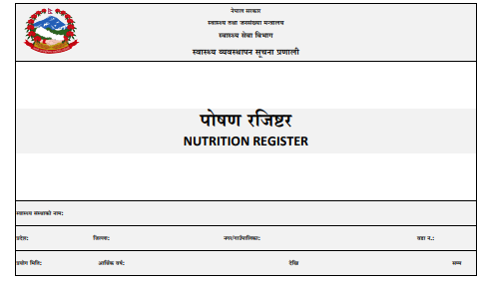
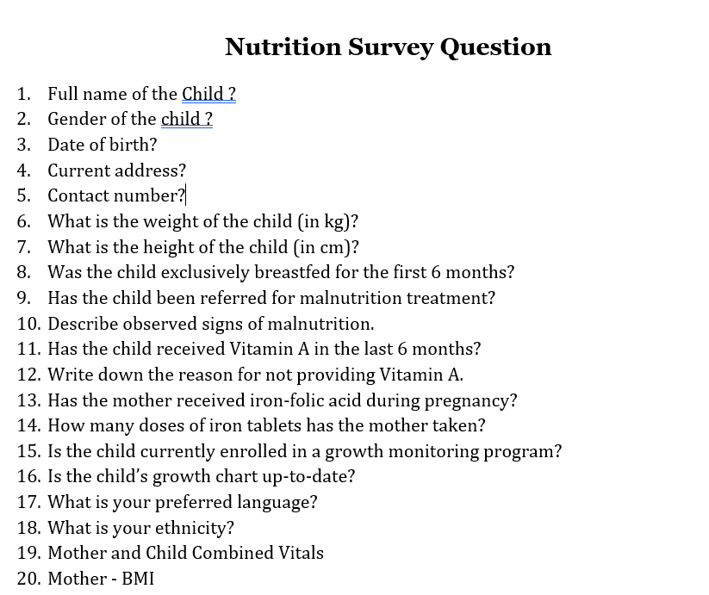
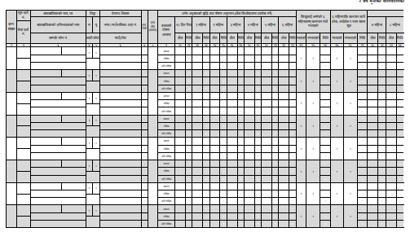
Various tools Used for Nutritional Status Identification

Slide 6
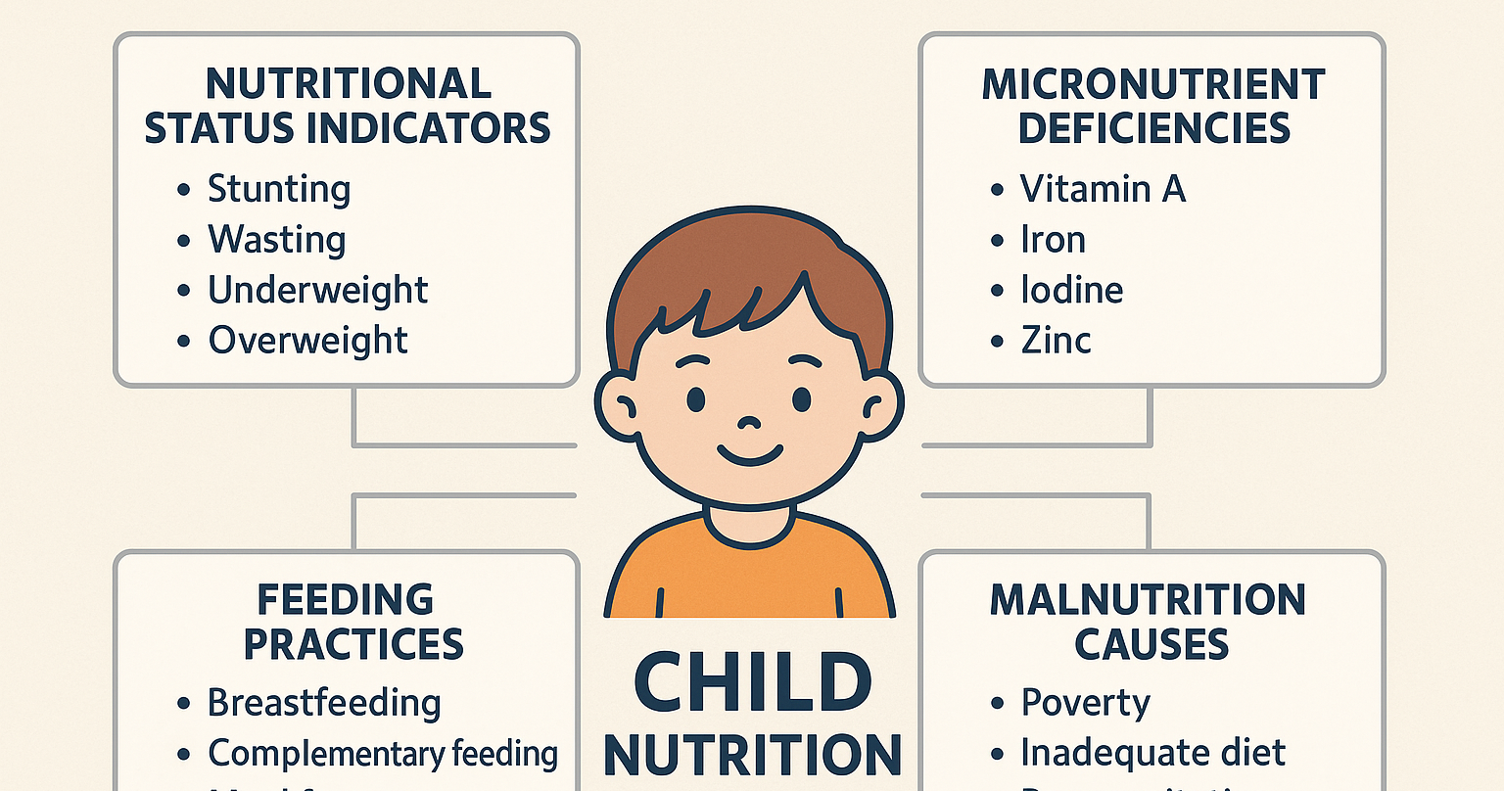

Slide 7
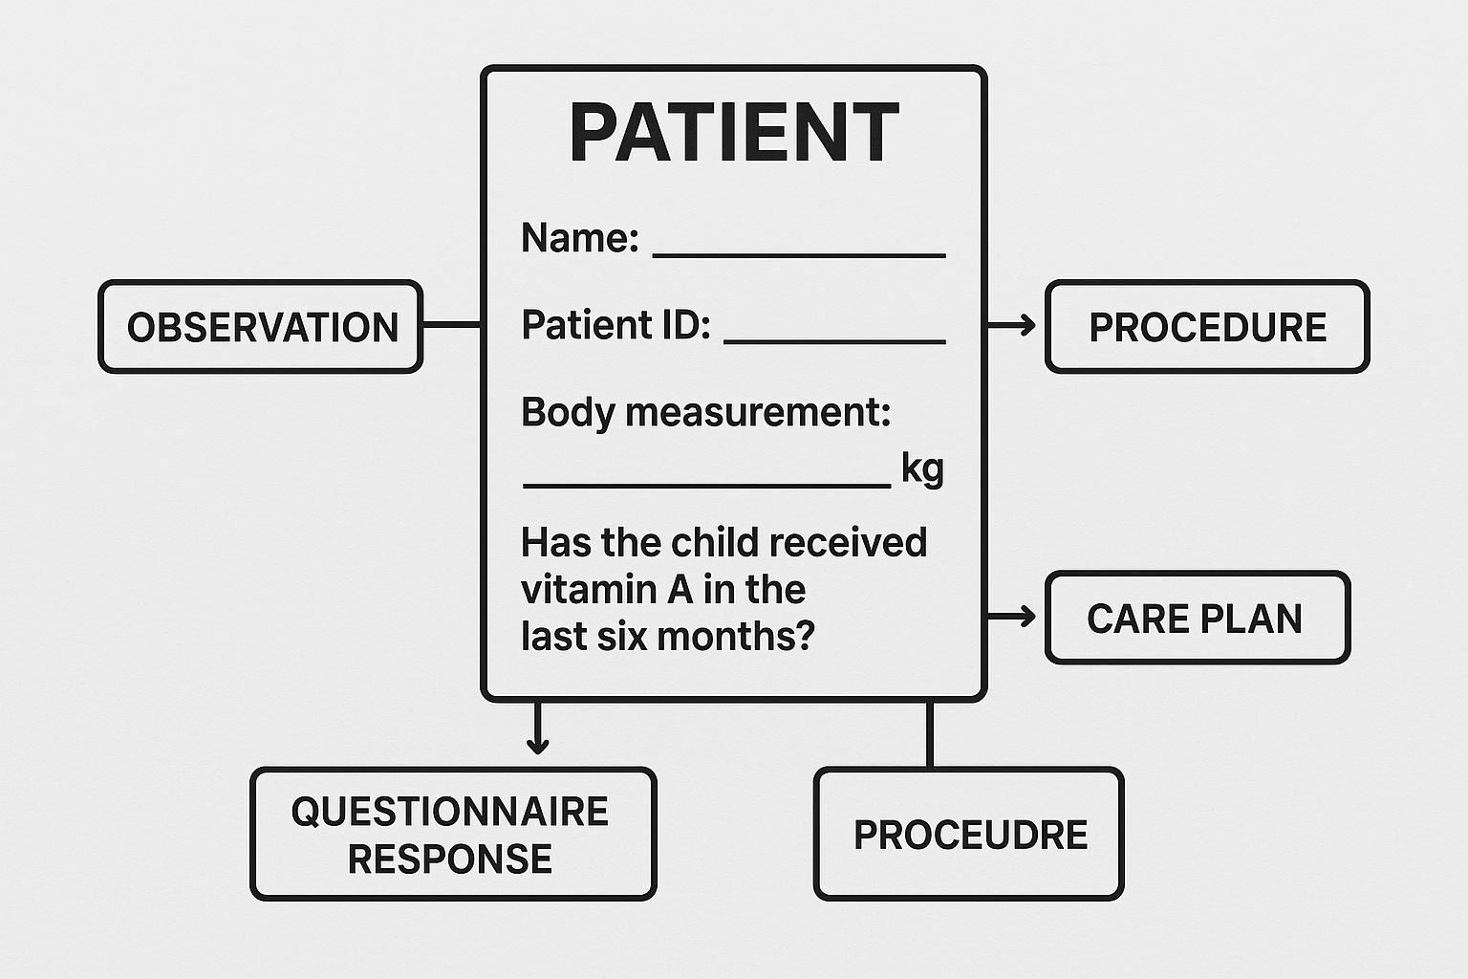
Questionnaire Development
Identification of key questions
Assess child demographics
Health status
Diagnosis treatment
Care planning

Slide 8
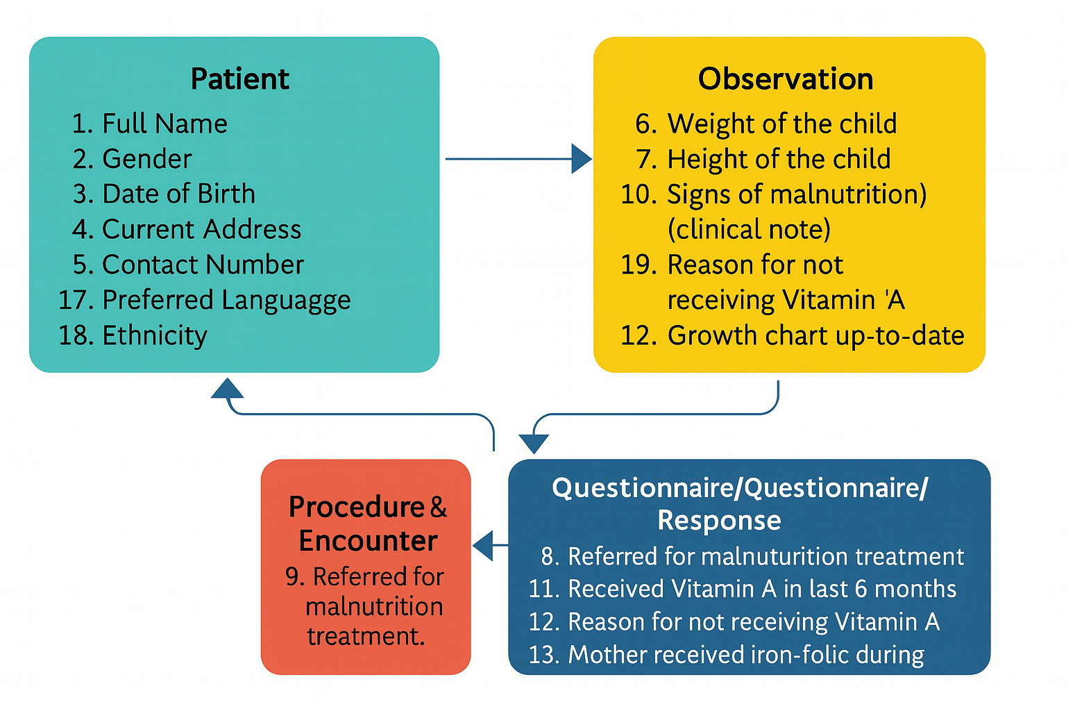
Segregation of Questionnaire into different resources

Slide 9
FHIR Resource Mapping
Key FHIR Resources Used:
Patient: Captures demographic data (name, gender, birthdate, address, ethnicity).
Questionnaire: Holds the nutrition survey structure.
Observation: Records vital signs for both mother and child in one entry.

Slide 10
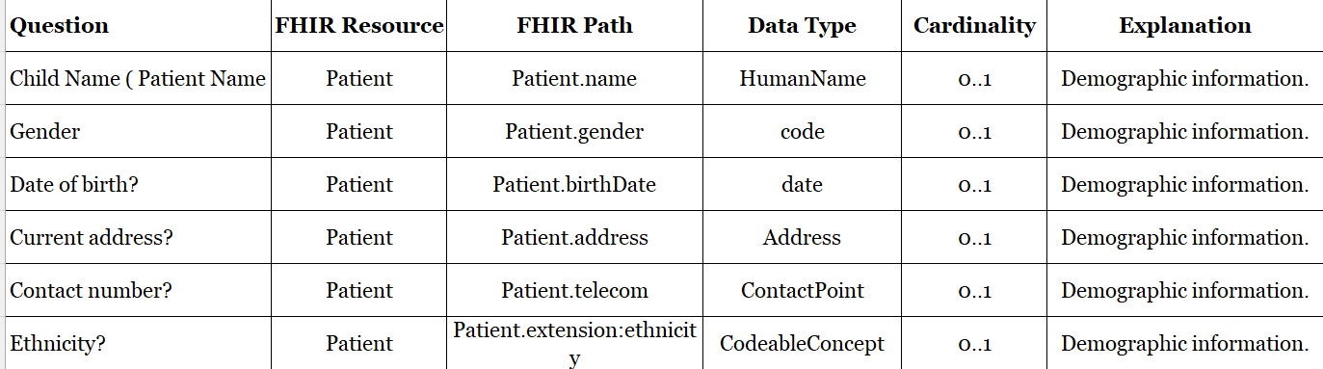
Resources Mapping of Patient Demographics

Slide 11
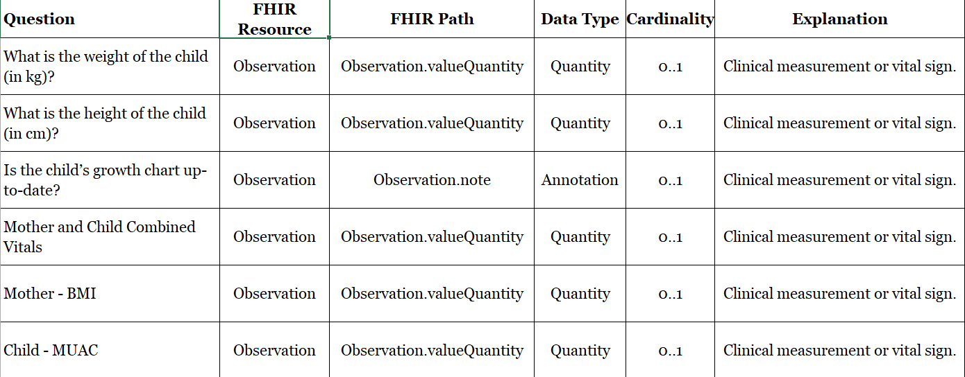
Resources Mapping of Patient Observation

Slide 12
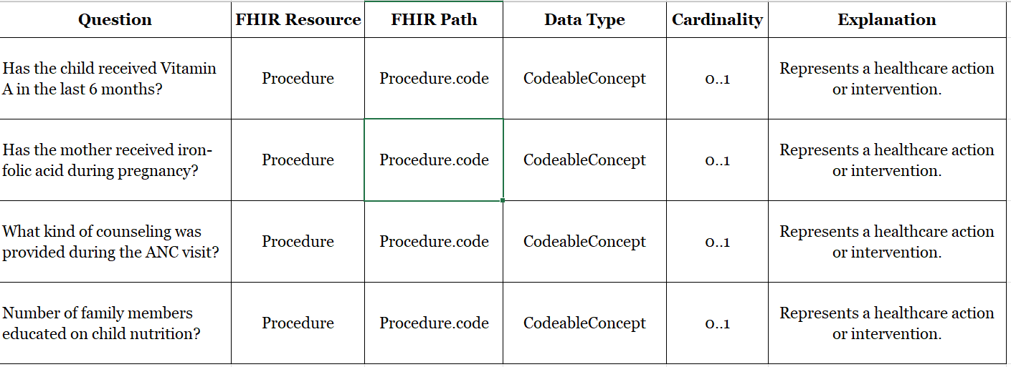
Resources Mapping of Procedure

Slide 13
Technical Implementation
FHIR JSON Structure:
Each resource type (question and observation ) is defined as a FHIR-compliant JSON element.

Slide 14
FHIR Implementation Challenges
Identify Nutrition Survey Questions
Learn FHIR Structure
Recognizing the types of data involved in the survey
Understanding how to structure data in FHIR-compliant JSON
Map Questions to FHIR Resources
Segregate Data into FHIR Resources
Matching survey questions to appropriate FHIR resources
Splitting the questionnaire into different FHIR resources

Slide 15
FHIR Survey Question Mapping Process
Step-by-Step Approach
Managing complexity by starting with simple questions
Using Examples
Guiding structure with sample FHIR JSON files
Team Discussions
Collaborative decision-making on question placement
FHIR Survey Question Mapping
Successfully mapping questions to FHIR resources

Slide 16
Achieving Successful FHIR Implementation
Address Terminology
5
Tackle challenges in mapping local concepts.
Document Decisions
4
Maintain detailed records for consistency.
Collaborate
3
Ensure ongoing communication between teams.
2
Validate Early
Regularly check for issues to prevent escalation.
1
Start Simple
Begin with core resources and minimal extensions.

Slide 17
Challenges and Barriers
Technical:
Mapping complex nutrition concepts to FHIR.
Handling multiple data types (boolean, integer, string).
Operational:
Training for digital data entry.
Ensuring data completeness and local adaptation.
Clinical:
Sensitivity and variability in nutrition reporting.

Slide 18
Impact & Next Steps
Impact:
Standardized, shareable nutrition data.
Supports better clinical care and public health decisions.
Next Steps:
Pilot testing in clinics.
Refinement based on feedback.
Integration with national health systems.

